Slide 1
Introduction to Work Measurement
Sections:
Time Standards and How They Are Determined
Prerequisites for Valid Time Standards
Allowances in Time Standards
Chapter 12

Slide 2
Some Definitions
Work measurement – evaluation of a task in terms of the time that should be allowed by an average worker to perform the task
4 techniques
Focus on human work

Slide 3
Some Definitions
Standard time (allowed time) – amount of time that should be allowed for an average worker to process one work unit using the standard method and working at normal pace
It includes some additional time is called allowance to provides for the workers:
To provide for the workers personal needs
To reduce fatigue
Unavoidable delay during the shift

Slide 4
Some Definitions
Time study – all the ways in which time is analyzed in work situations.
How much time it should take to accomplish a given task.
Both terms (work measurement and time study) can be used interchangeably.

Slide 5
When Are Time Standards Beneficial?
Characteristics of industrial situations in which time standards would be beneficial:
Low productivity: significant opportunities for improvement
Repeat orders: once the time standard is set for the first, it can be used for successive ones
Long production runs: reduced average cost of work measurement
Repetitive work cycles: work measurement can be justified more readily
Short cycle times: requires less time to set standards

Slide 6
Functions of Time Standards
Defines a fair day’s work.
They provide a means to convert workload into staffing and equipment needs
They allow alternative methods to be compared objectively
They provide a basis for wage incentives and evaluation of worker performance
They provide time data for:
Production planning and scheduling
Cost estimating
Material requirements planning

Slide 7
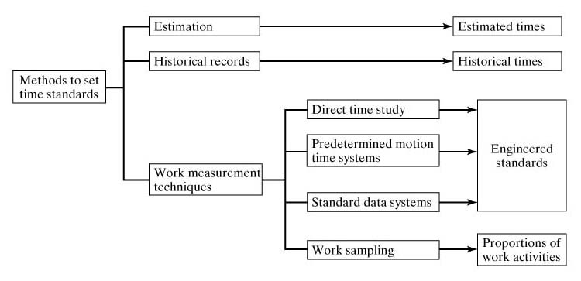
Methods to Determine Time Standards
Vary in terms of
accuracy and reliability of the values derived from the method
amount of time required to apply the corresponding method

Slide 8
Methods to Determine Time Standards
Estimation
Judgment of a person who is familiar with the job
Subjective
Least accurate method
Historical records
Records on the actual times and production quantities for previous identical or similar job orders - “Time card”
Average time per part
Improvement over estimates
Limitation: No indication of efficiency measures
Work measurement techniques
Time consuming
More accurate than estimation and historical records

Slide 9
Work Measurement Techniques
Direct time study (DTS)
Predetermined motion time system (PMTS)
Standard data systems (SDS)
Work sampling

Slide 10
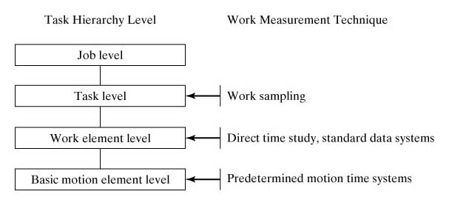
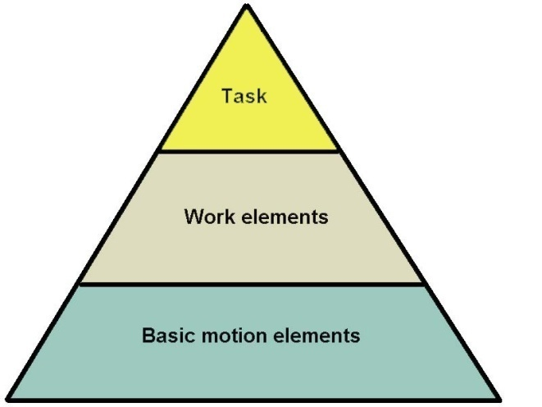
Task Hierarchy & Work Measurement
Pyramidal Structure of Work
Work measurement techniques measure work at different levels of this hierarchy

Slide 11
1. Direct Time Study
Direct observation of a task using a stopwatch to record the time taken to accomplish a task.
The task is usually divided into work elements and each work element is timed seperately.
During the observation, the analyst evaluates the worker’s pace - performance rating
Normal time
T_{n}=T_{obs}(PR)
where T_{n} = normal time, min;
T_{obs}= observed time, min;
PR = performance rating of the worker’s pace
Standard time
T_{std} =T_{n}(1+A_{pfd})
A_{pfd}
= allowance factor for personal time, fatigue and delay

Slide 12
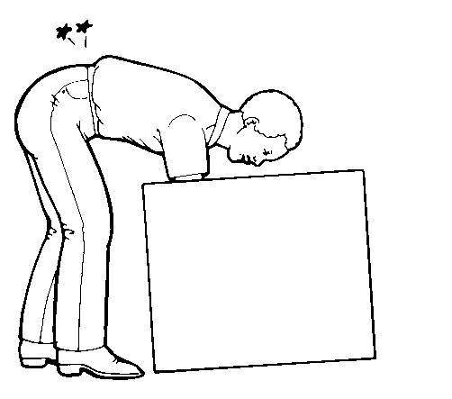
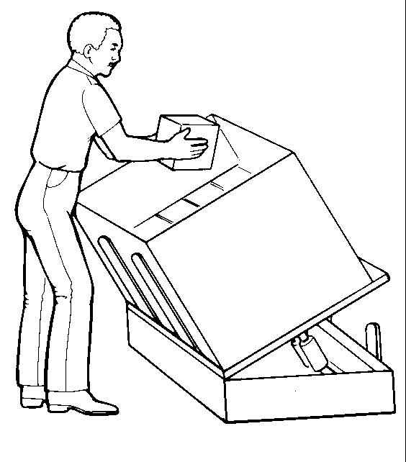
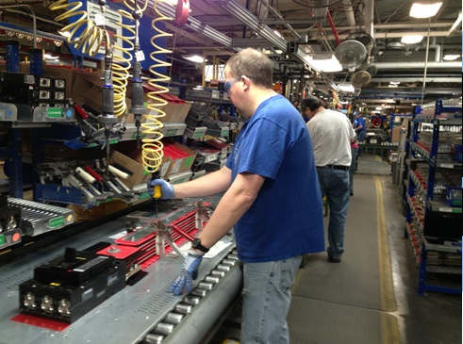
2. Predetermined Motion Time Systems
A database of normal times of basic motion elements (therbligs) such as reach, grasp, move etc.
Conditions under which the motion elements (work variables) are performed are important.
Example: normal time for object reach
Distance moved
Weight of the object being moved
The analyst list all of the basic motion elements that comprise the task; then normal times for basic motion elements are summed up to obtain the normal time for the task.
Advantages:
No need for performance rating
Can be applied before production starts

Slide 13
3. Standard Data Systems
A compilation of normal time values for work elements used in the tasks performed in facility
Used to establish time standards for tasks composed of work elements similar to those in the database
Source of data: direct time study, PMTS, work sampling, historical data
Effect of work variables should be included
Tables
Charts
Mathematical equations

Slide 14
4. Work Sampling
A random sampling technique to estimate the proportions of time spent in different activities
Identify activities clearly.
Example: machine setup, production, idleness
Multiple subjects (entities) can be included
Observations
Random: minimize bias
Large in number: to achieve statistical accuracy
Objectives:
Setting time standards
Estimating resource utilization
Determining allowance factors

Slide 15
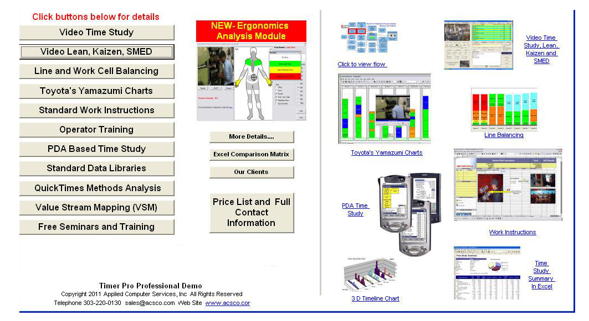
Computerized Work Measurement (work study methods)
Facilitates collection of data
Performs routine computations
Organizes time standards files and databases
Retrieves data in predetermined motion time systems and standard data systems
Assists in the preparation of the documentation
Methods descriptions
Reports

Slide 16
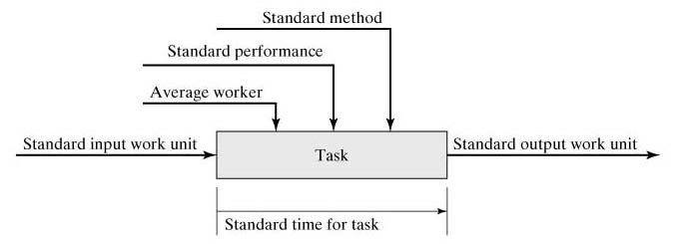
Prerequisites for Valid Time Standards
Time to perform a task depends on various factors:
Worker (gender, strength, physical capability and mental abilities etc.),
Worker’s pace (speed, skill, experience),
Method used (hand tools, equipment, hand & body motion, wok environment)
Work unit (nature of work or task)
Factors that must be standardized before a time standard can be set (except for the worker)

Slide 17
Average Worker & Standard Performance
Average worker
is a person who usually perform tasks similar to the task being measured.
Gender factor, if the work is performed mostly by men ( not women), then the average worker is male ( not female)
Age factor
Have learned the task (experience and skill), practiced and proficient at it
Is capable of performing the task consistently throughout the shift with safety condition and without fatigue

Slide 18
Standard (Normal) Performance
Standard Performance is a pace (quantity & quality) of working that can be maintained by an average worker throughout an entire work shift without harmful effects on the worker’s health or physical well-being.
Normal performance refers to 100% pace while the worker is working without including the breaks period or any delay.
Standard performance refers to 100% pace with the breaks period and any other delay during the shift.

Slide 19
Normal time / Standard time
Normal time: Time it takes to perform a task under the normal (standard) (100%) performance
Normal time is also called: Normalized time OR basic time
Normal time does not include allowances for time losses (breaks or delay)
Standard time minus allowances time = Normal time
Standard time: Normal time + allowance
Normal time (1 + A_{pfd})
T_{std} =T_{n}(1+A_{pfd})

Slide 20
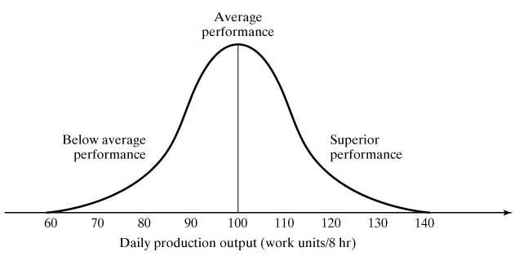
Distribution of Worker Performance
Variations among workers →performance variations
Worker performance is expressed in terms of daily output

Slide 21
More on Standard Performance
Standard performance is commonly defined to be a pace that can be readily attained by the majority of workers
Companies want most workers to be able to achieve the standard performance easily.
A typical policy is to define standard performance so that an average worker is able to work at a pace that is 130% of that pace
Thus, most workers are able to easily achieve standard performance

Slide 22
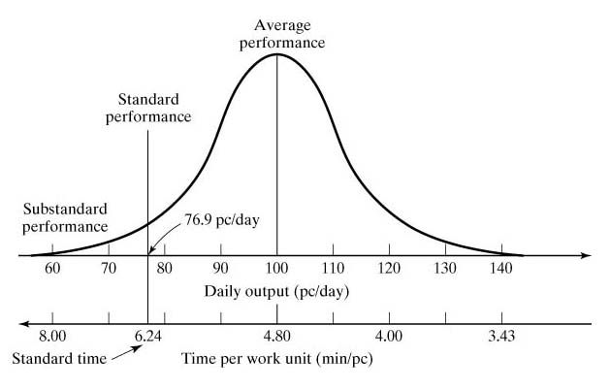
How a Standard Time is Defined
Distribution of worker performance, indicating how standard time is defined so that it can be readily achieved by most workers
4.80*1.30
8 * 60 / 100

Slide 23
Standard Method
Determining the optimum method for processing a work unit
“One best method”: the safest, quickest, most productive, and least stressful to the worker
Must include all of the details on how the task is performed, including:
Procedure - hand and body motions
Tools (hand tools, power tools, fixtures and gauges)
Equipment
Workplace layout (what are the locations of the parts, tools)
Irregular work
Working conditions (is the work performed outside or inside)
Setup (what setup of physical tools & equipment are required)

Slide 24
Allowances in Time Standards
Normal time is adjusted by an allowance factor A_{pfd} to obtain the standard time
Purpose of allowance factor (A_{pfd}) is to compensate for lost time due to work interruptions and other reasons during the shift.
Standard time:
T_{std} = T_{n}(1 + A_{pfd})
where pfd = personal time, fatigue, and delays

Slide 25
Reasons for Lost Time at Work
Work-related interruptions
Machine breakdowns
Waiting for materials or parts
Receiving instructions from foreman
Talking to co-workers about work-related matters
Rest breaks for fatigue
Cleaning up at end of shift
Non-work-related interruptions
Personal needs (e.g., restroom breaks)
Talking to co-workers about matters unrelated to work
Lunch break (not included in A_{pfd})
Smoke break
Drink break
Personal telephone call

Slide 26
PFD Allowance (Cont.)
Personal time
Rest room breaks, phone calls, water fountain stops, cigarette breaks (5% typical)
For example: A larger value will be approporiate if the work environment is hot
Fatigue (Physical fatigue OR Mental fatigue)
Rest allowance to overcome fatigue due to work-related low or medium stresses and conditions (5% or more)
For example: If the work is physiologically very demanding (heavy workload), then relaxation time should be allowed periodically for the body to recover (in this case use 20% allowance)
Delays
Random, unavoidable interruptions
Machine breakdowns, foreman instructions (5% typical)
Usually management is responsible for these delays.

Slide 27
Calculate the PFD Allowance Time (Relaxation allowances)
Direct calculation includes:
PFD Allowance
(% of normal time)
Personal needs
5%
Fatigue (Physical or Mental)
5%
(Low or Medium Fatigue)
Delay
5%
20%
(High Fatigue)

Slide 28
Factors causing Fatigue in Workers
1- Physical Factors
Standing, Abnormal body position (Awkward posture), Use of force, Expenditure of muscular energy
2- Mental & cognitive Factors
Concentration & attention, mental strain, Monotony, Eye strain, Noise
3- Environmental & work Factors
Poor lighting, Noise, Fumes, Heat, Atmospheric conditions (Ventilation), Dusts, Dirt, Wet

Slide 29
Other Types of Allowances
There are other reasons for adding allowances, which are not as common as PFD allowances. They are applied in addition to A_{pfd}
Contingency طوارئِ allowance
Additional allowance due to a problem with the task (e.g., raw material problem ) - not greater than 5%
Temporary basis – after solving the underlying problem, it will disappear
Policy allowance: They are based on company policy
Machine allowance - (set by company policy as a part of the wage incentives.)
Training allowance – for teaching new workers (for workers whose responsibilities include teaching other workers)
Learning allowance – learning a new task (for workers who are learning a new job, or new employees)

Slide 30
Contingency Allowances

Slide 31
How to Allow for Lost Time
Two approaches used by companies:
Scheduled rest breaks during the shift
Typical - one 15-minute break in mid-morning and another in mid-afternoon
A PFD allowance factor is added to the normal time
This allows the worker to take a break on his/her own time
PFD is called Relaxation Allowances represented in % value
Relaxation allowance OR PFD are calculated to allow the worker to recover from fatigue

Slide 32
Example: Standard time
Problem # 12.3 (page 340)
The ABC Company uses a standard data system to set time standards. One of the time study analysts listed the three work elements for a new task to be performed in the shop and then determined the normal time values to be 0.73 min, 2.56 min, and 1.01 min. The company uses a PFD allowance factor of 16%. Determine the standard time for the task.
Solution:
Normal time T_{n} = 0.73 + 2.56 + 1.01 = 4.30 min
Standard time T_{std} = 4.30(1 + 0.16) = 4.988 min
T_{std} = T_{n}(1 + A_{pfd})

Slide 33
Example: PFD Allowance factor
Problem # 12.5 (page 341)
In the WS&FP plant, workers punch in at 8:00 a.m. and punch out at 5:00 p.m. The labor‑management agreement allows one hour for lunch, which is not counted as part of the 8‑hour shift. In determining the allowance for computing time standards, two 12 min breaks are included (personal time and fatigue), one in the morning and one in the afternoon; and 35 min are included as lost time due to interruptions and delays. What PFD allowance factor should be added to the normalized time to account for these losses in the computation of a standard time, so that if the worker works at standard performance, he/she will earn exactly eight standard hours?

Slide 34
Example: PFD Allowance factor
Solution
T_{std} = T_{n}(1 + A_{pfd})
T_{std} = 8 h = 8 x 60 = 480 min
Allowance time = 2x12 + 35 = 59 min
T_{std} = T_{n} + A
T_{n} = 480 – 59 = 421 min
480 = 421 (1 + A_{pfd})
A_{pfd} = 0.14 (or 14%)

Slide 35
PROBLEM # 12.7 (Page 341)
The work shift at the ABC Company runs from 7:30 a.m. to 4:15 p.m. with a 45 min break for lunch from 11:30 to 12:15 p.m. that does not count as part of the work shift (workers are not paid for this time). The company provides two 12-min rest breaks during working hours (paid time), one in the morning and one in the afternoon. The company also allows 25 min per day for personal needs (paid time). In addition, a work sampling study has shown that on average, unavoidable delays in the plant result in 20 min lost time per worker per day (paid time). Determine the PFD allowance factor for the following two management policies on allowances: (a) the two 12-min breaks are both scheduled breaks that all workers take at the same time (not included in the allowance time) and (b) the two 12-min breaks are included in the allowance factor so that workers can take their breaks whenever they please.

Slide 36
PROBLEM # 12.7 (Page 341)
Solution
(a) Allowance time = 25 min (personal) + 20 min (delay) = 45 min
Rest Breaks = 2x12 = 24 min (excluded from standard time)
Standard time (T_{std}) = 480 – 24 = 456 min
Normal time (T_{n}) = 456 – 45 = 411 min
T_{std} = T_{n} (1+ A_{pd})
Allowance factor A_{pd} = (456/411) – 1 = 0.1095 = 10.95%
(b) Allowance time = 25 min (personal) + 20 min (delay) = 45 min
Rest Breaks = 2x12 = 24 min (included in standard time)
Standard time (T_{std}) = 480 min
Normal time (T_{n}) = 480 – 45 – 24 = 411 min
T_{std} = T_{n} (1+ A_{pfd})
Allowance factor A_{pfd} = (480/411) – 1 = 0.1679 = 16.79%

